Slide 1

Short journey into posttransplant care – images and impressions
Anikó Bohács M.D. PhD, Eszter Csiszér, ZoltánSüttő, Noémi Eszes, Zsófia Lázár , Adrián Kis, Zsuzsanna Kováts, Prof. Veronika Müller, Prof. György Losonczy
Department Of Pulmonology Semmelweis University, Budapest
.

Slide 2



What kind of skills need to care after Lung transplantation
Human resources:
Learning curve: special, transplant training for the pulmonologist , nurses, physiotheraputics in a lung transplant center.
European Reapiratory Sociations
Vienna Lung Transplantation Academy
Europran CF socity
Multispecialty background: university with transplant experience

Slide 3

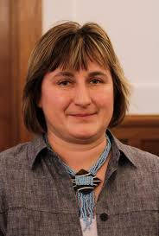
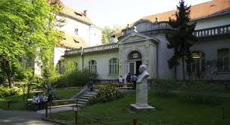
Learning curve’s early phase of the hungarian posttransplant team
1996 LuTx avaiable for Hungarian patients
Refer LuTx candidate to the center (dr Csiszér, Zsiray)
Post LuTx was Wienna
Prof. Klepetko,
Prof. Gy. Lang
Prof. Peter Jaksch
2002: K. Czebe was 1,5 year in Wienna for practical, clinical training.
From 2005 the surveillance control was in the National Korányi Institute of Pulmonology.

Slide 4
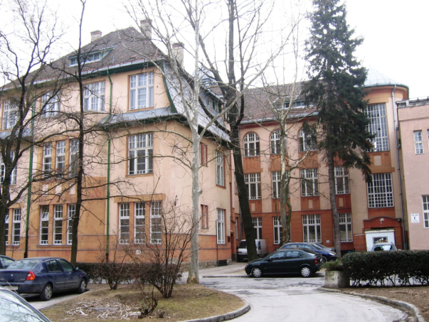
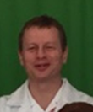
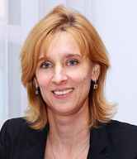
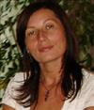
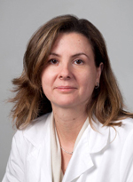

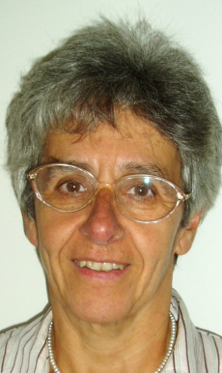
Site of the adult posttransplant care: from 2008 in the Dep. Of Pulmonology, Semmelweis Univ.
Hospital ward and outpatient
Zoltán Süttő
Veronika Müller
Anikó Bohács
Gabriella Muraközy
Pulmonologist under training in LuTx field: Zsuzsa Kováts, Noémi Eszes, Zsófia Lázár, Adrán Kiss
Outpatient doctor: Eszter Csiszér ;
keep a check on stable LuTx patients
Children LuTx are under control in Dep. Of I. Pediatric : Dr Kovács Lajos

Slide 5
Increasing number of outpatient and hospitalised LuTx patients.

Slide 6
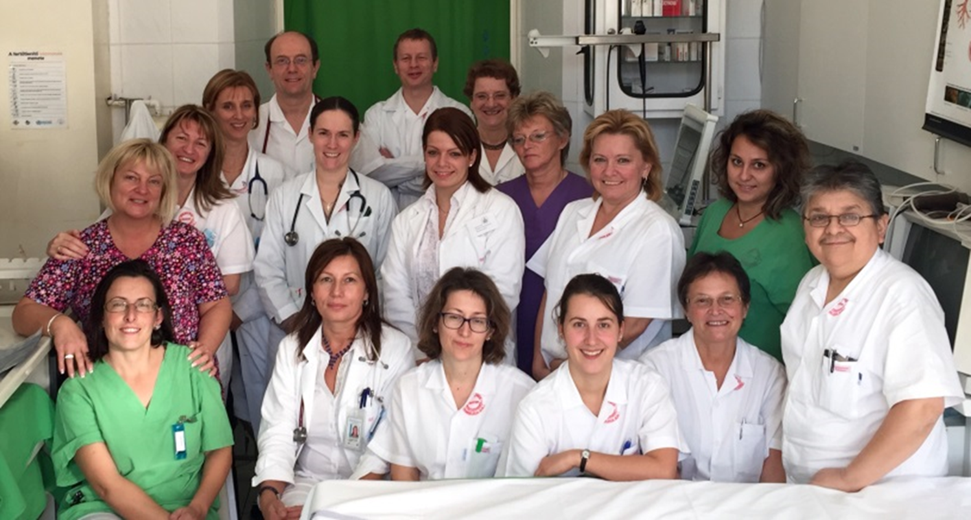
Posttransplant medical team in Dep. of Pulmonology
Pulmonologists, cardiologist, anestesiologist
Assistant of bronchology, and of spirometry units
Physiotheraputics, nurses
Administrator

Slide 7
Control, monitoring the LuTx patients
Diagnostic procedure | Weeks |  |  | Months | Months after the first year
 | 3 or 4 | 5 6 7 | 8 10 12 | 4 5 6 7 8 9 10 11 12 | 1 2 3 4 5 6 7 8 9 10 11 12
Bronchoscopy | X |  | X X | X X
Chest X-ray | X | X X X | X X X | X X X X X X X X X | X X X X X X
Lung functions and diffusion | X | X X X | X X X | X X X X X X X X X | X X X X X X
Blood gases | X | X X X | X X X | X X X | X X
Routrine laboratory * | X | X X X | X X X | X X X X X X X X X | X X X X X X
Drug monitoring | X | X X X | X X X | X X X X X X X X X | X X X X X X
CMV Ag screen | X | X X X | X X X | X X X X X X X X X | X X X X X X
EBV serology |  |  | X | X X X | X X X X
HgbA1c |  |  | X | X X X | X X X X
Bonenenzymes |  |  | X | X X | X
24h urin |  |  | X | X X | X
Sutum and/or swab culture# |  |  | X | X X | X
Chest CT scan | X |  |  | X X | X
Nephrology |  |  |  | X X | X
Osteodesitometry |  |  |  | X | X
Rheumatology |  |  |  | X | X
Gynecology//urology |  |  |  | X | X
Dermatology |  |  |  | X | X

Slide 8

Adult Lung Transplants
Age Distribution by Diagnosis
(Transplants: January 2004 – June 2015)
2016
JHLT. 2016 Oct; 35(10): 1149-1205

Slide 9
Indications of LuTx in hungary 2016

Slide 10
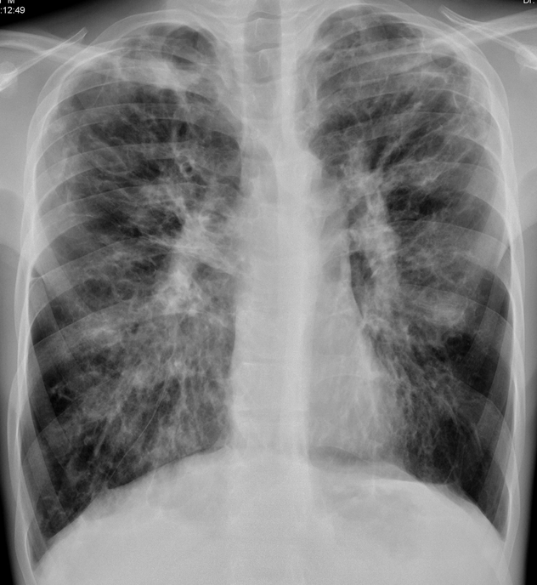
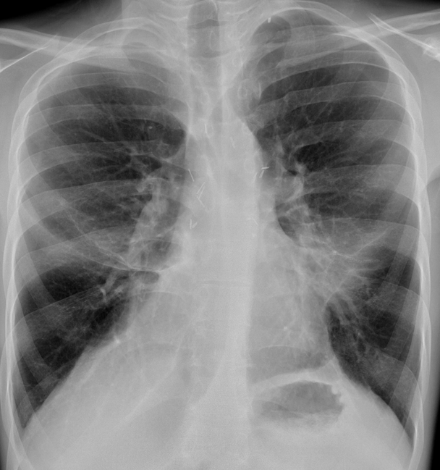
Lung transplantation in CF patient
Before LuTx
After LuTx

Slide 11
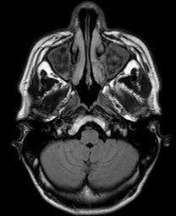

Balance between the immunosuppression and infection
Infective problems of CF patient Multidrug resistant pathogens in CF patients (MDR pseudomonas aer.), Aspergillus, Atyical mycobacteriums.
Sinus reservoar (chr. sinusitis)
Decreased of the ciliar clearance because of denervation.
Long life immunosuppression (calcineurin inhibitor+mycofenolat+prednisolon) (100% Reimbursement ISU drugs)

Slide 12
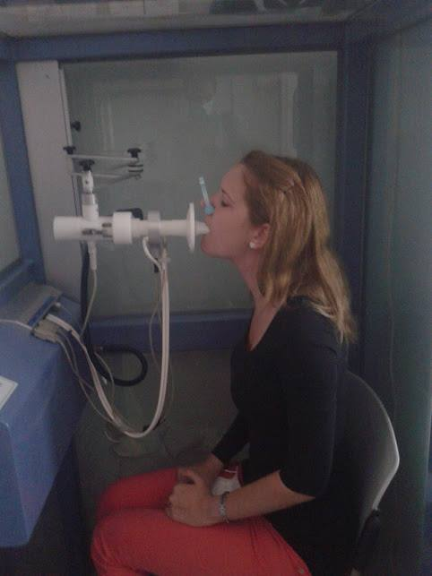
Spirometry control
In the first 3 month min. 12 .

Slide 13
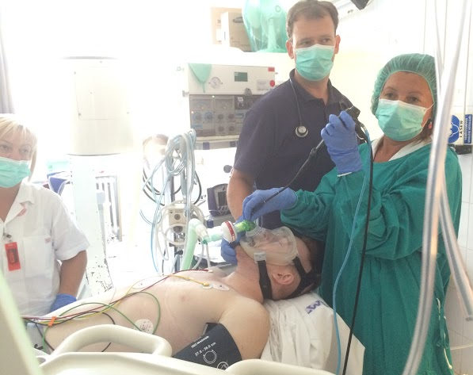
Bronchoscopy, transbronchial biopsy in midazolame i.v. sedation.
109 examination in the last year (2016)
With total sedation+ jet ventilation:
Intervention (stenosis ballon dilation)
Sleep apnoe
Resp. Insuff. chr. Lung allograft dysfunction

Slide 14
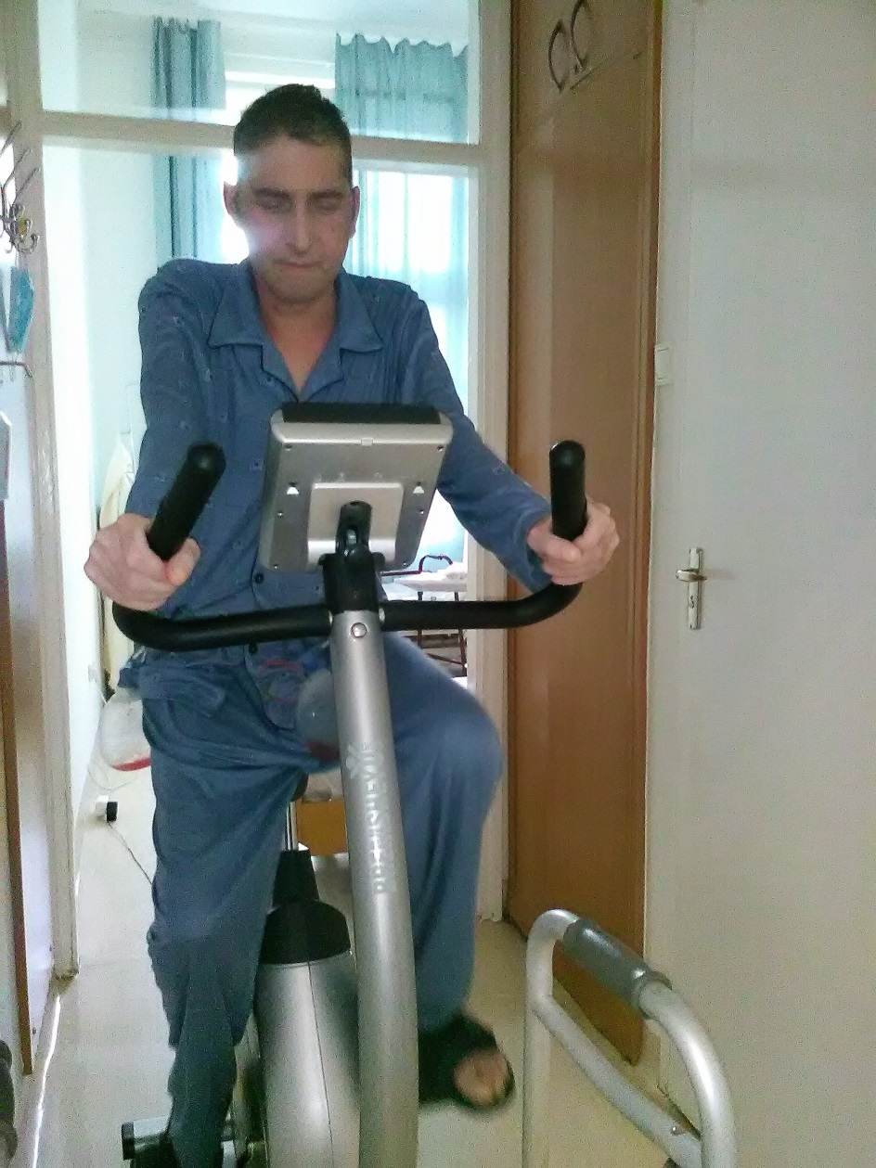
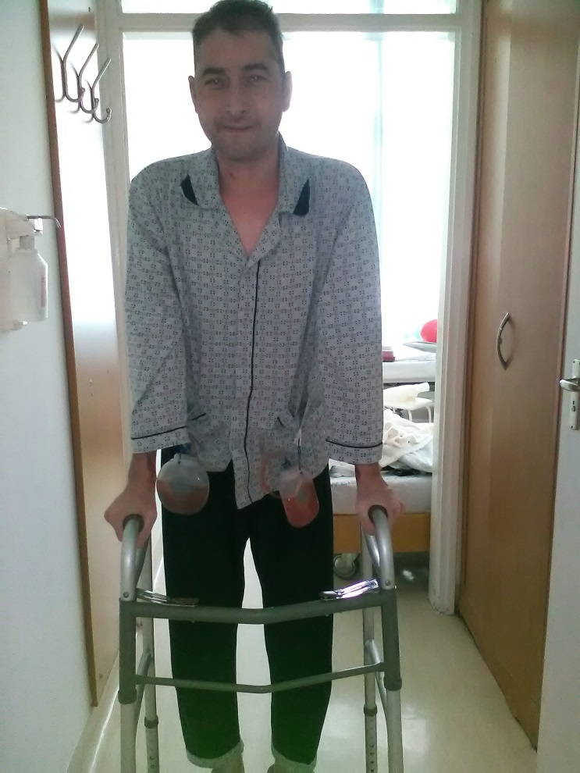
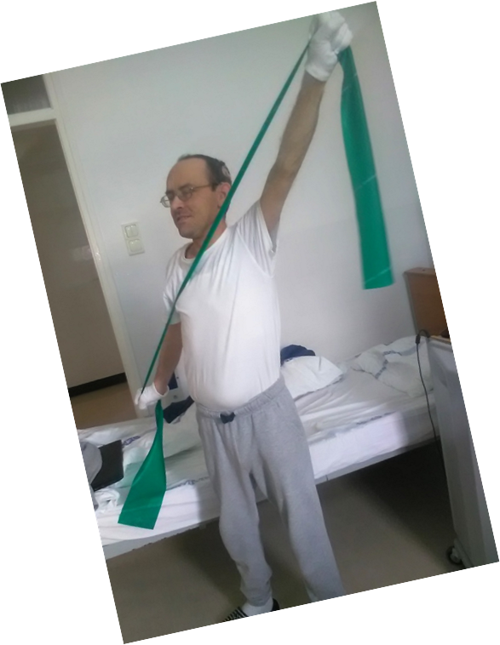
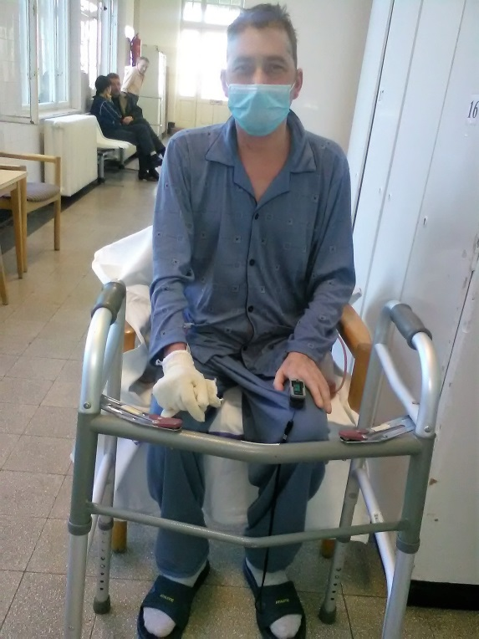
The first step
3.weeks after LuTx

Slide 15
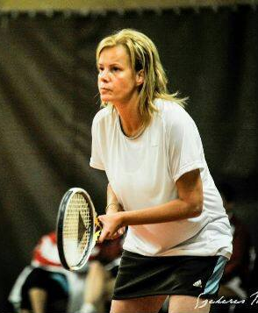
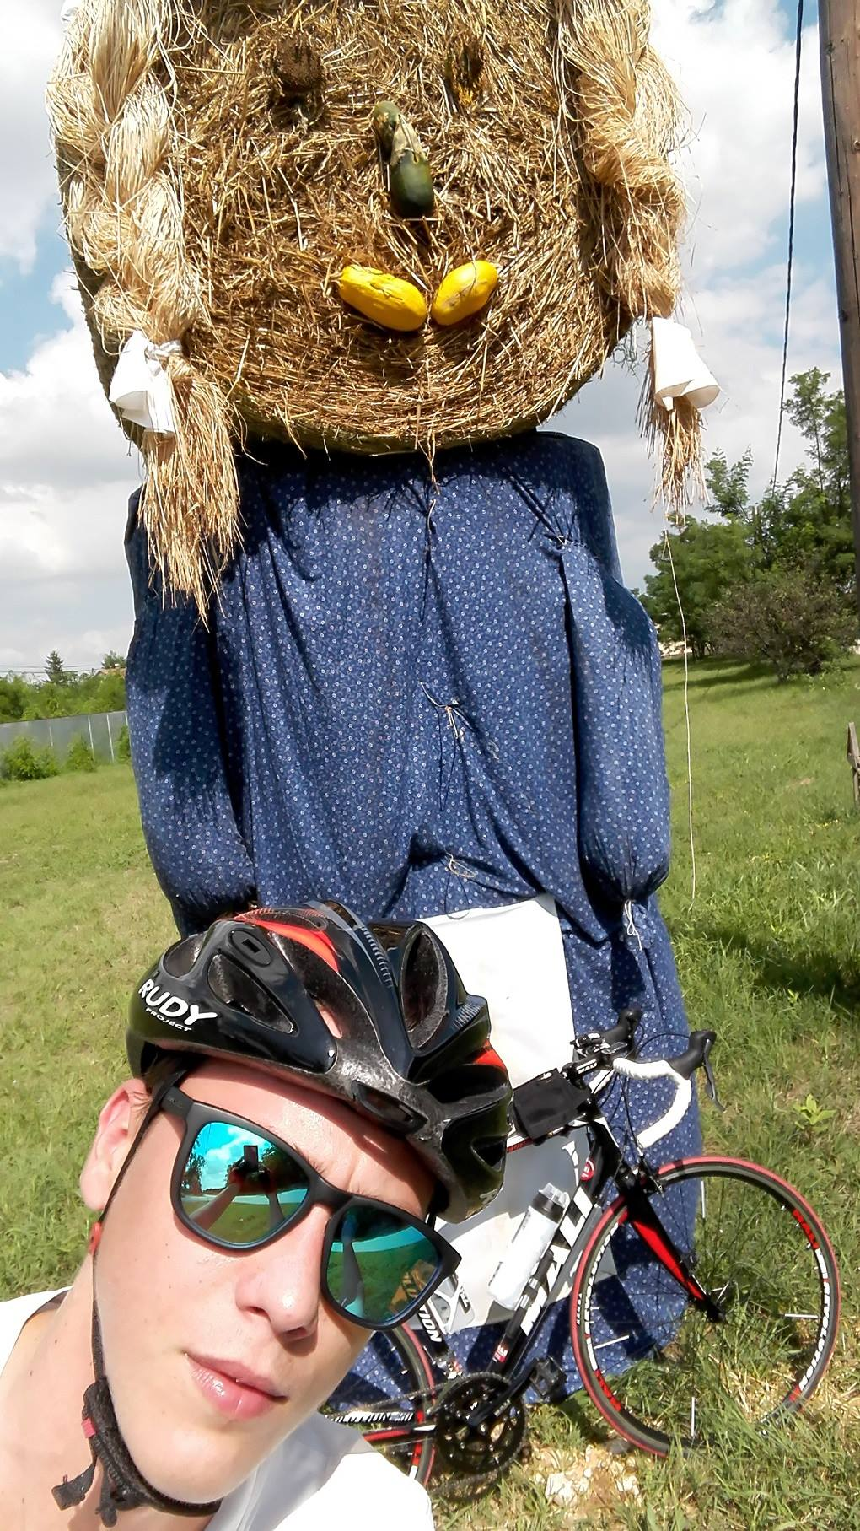
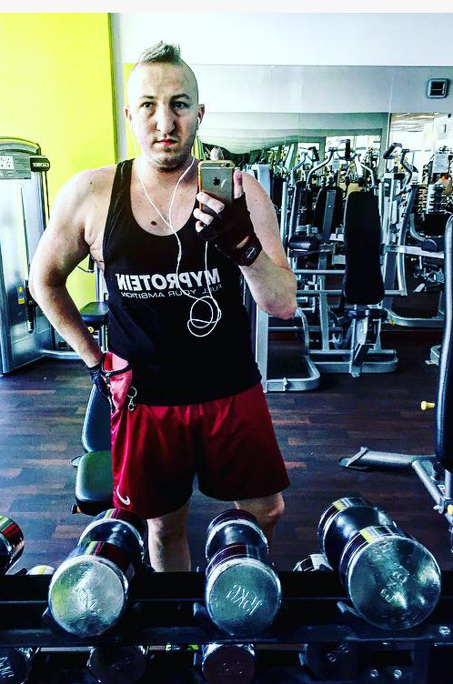
Sport after luTx

Slide 16

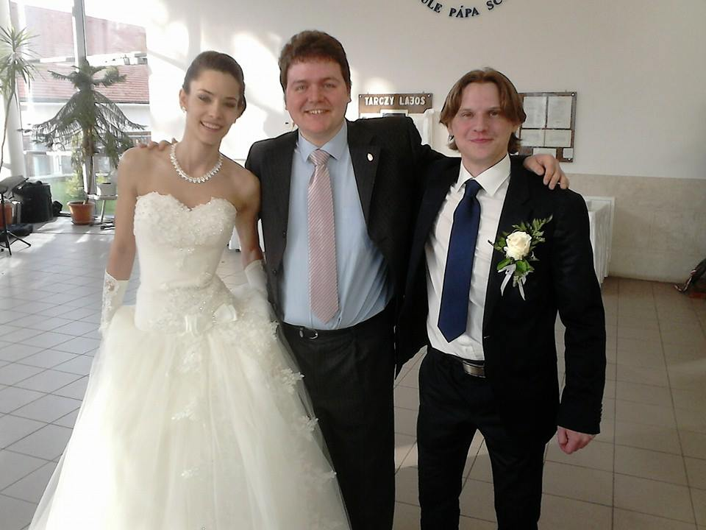
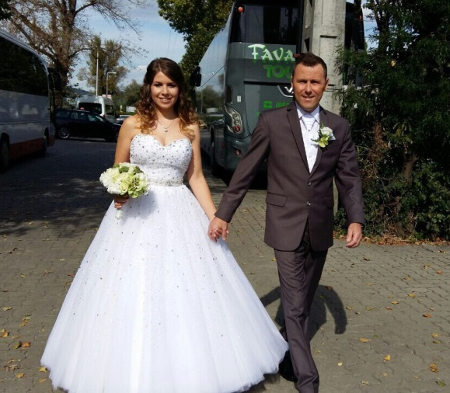
„the most beautiful moments”

Slide 17
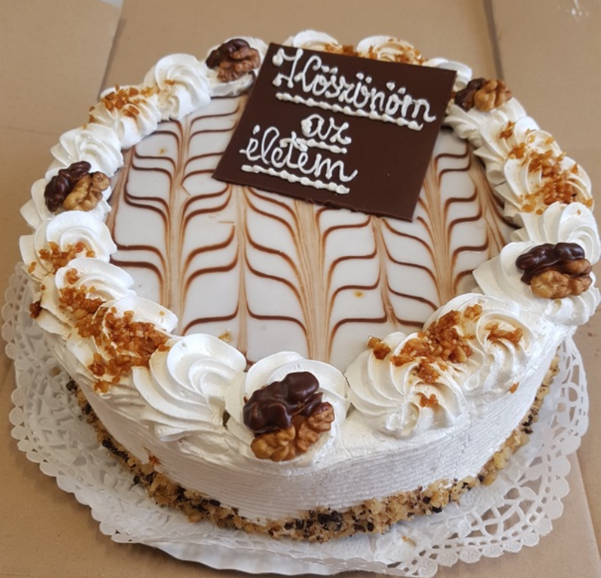
Thank you for my life!

