Slide 1

Who we are
Facts and figures from the Hungarian CF Registry
28.09.2017 – 01.10.2017
Gárdony, Hungary
Geza Marsal
Vice President
Hungarian Association of Cystic Fibrosis Adults

Slide 2
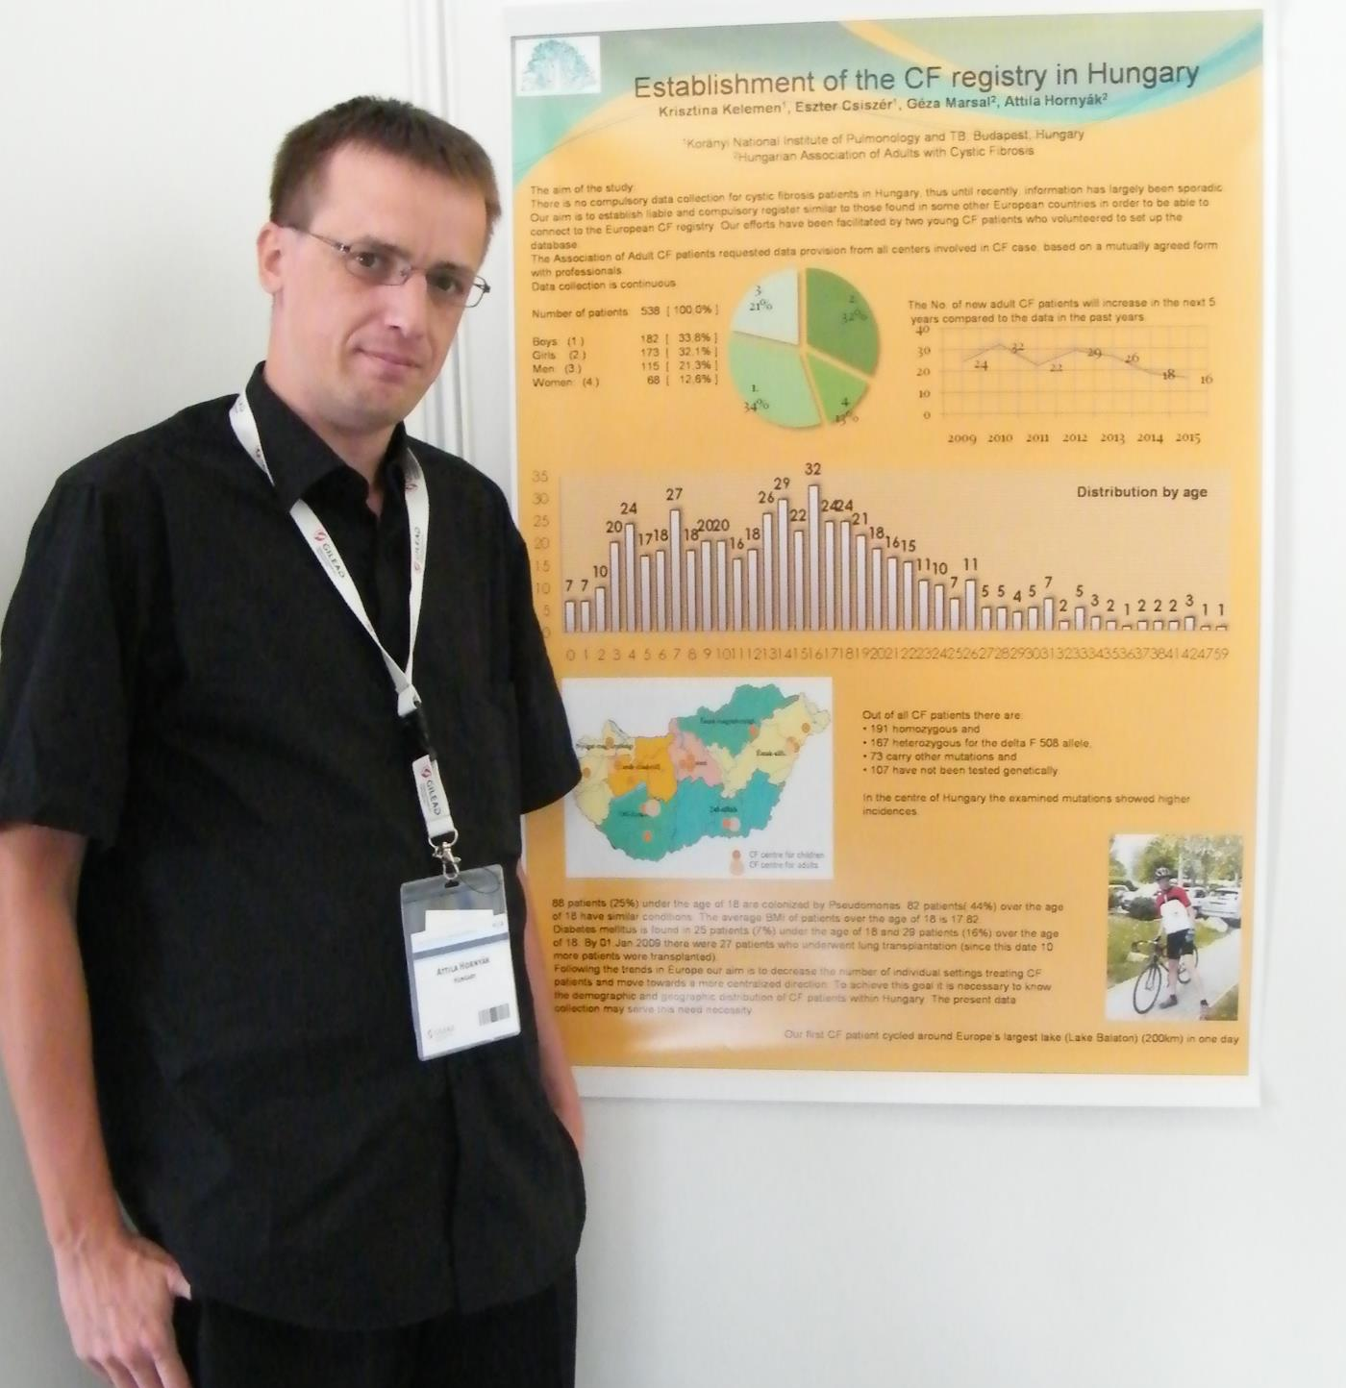
WHAT WE DO
Purpose of the CF registry
MEASUREMENT
Measuring, surveying, comparing aspects of CF and its treatment and providing data for the actual scientific purposes
REPRESENTATION OF INTEREST
Advocacy work through providing clear picture about the status of the Hungarian CF patients and their care
STRATEGY
Answering the current questions with facts depending of the needs of the decision makers.
INTEGRATION
Successful collaboration with the ECFS Patients Registry since 2008

Slide 3
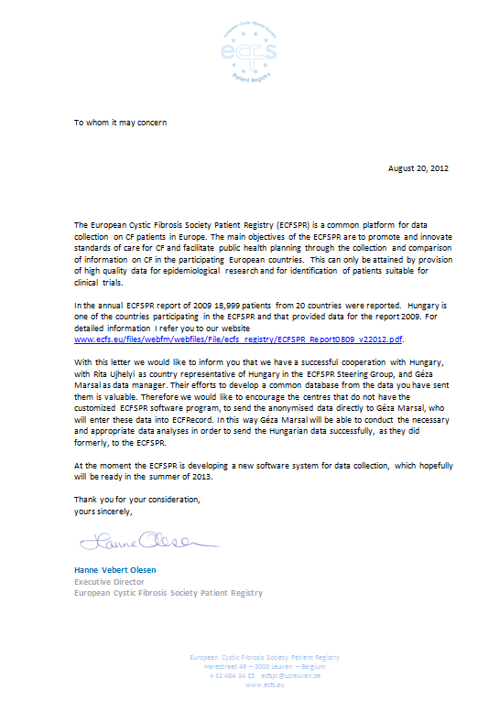
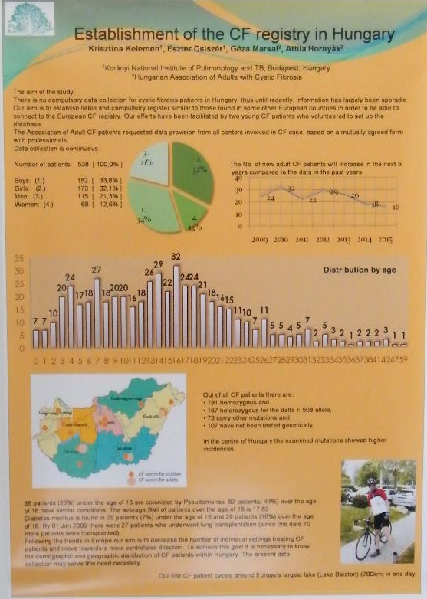
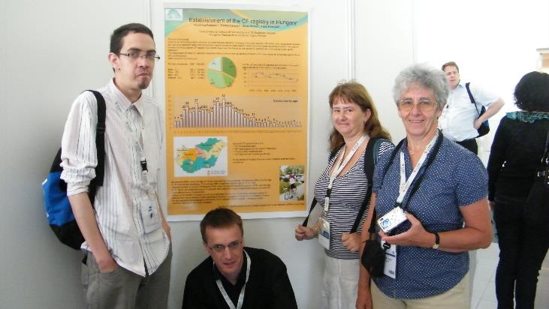

HUNGARIAN CF REGISTRY
www.cisztasfibrozis.hu
TEAMWORK
Maintained by the Hungarian Association of Cystic Fibrosis Adults, strong cooperation with CF centers and professionals
CORE TEAM
Dr. Ujhelyi Rita country representative
Dr. Csiszér Eszter sponsor, coordinator
Hornyák-Kovács Attila data manager
Marsal Géza country data manager
CERTIFICATION
Approved by the Medical Research Council
(11.05.2011)
APPEREANCES
Presenting results on the annual scientific meetings in HU and in EU

Slide 4
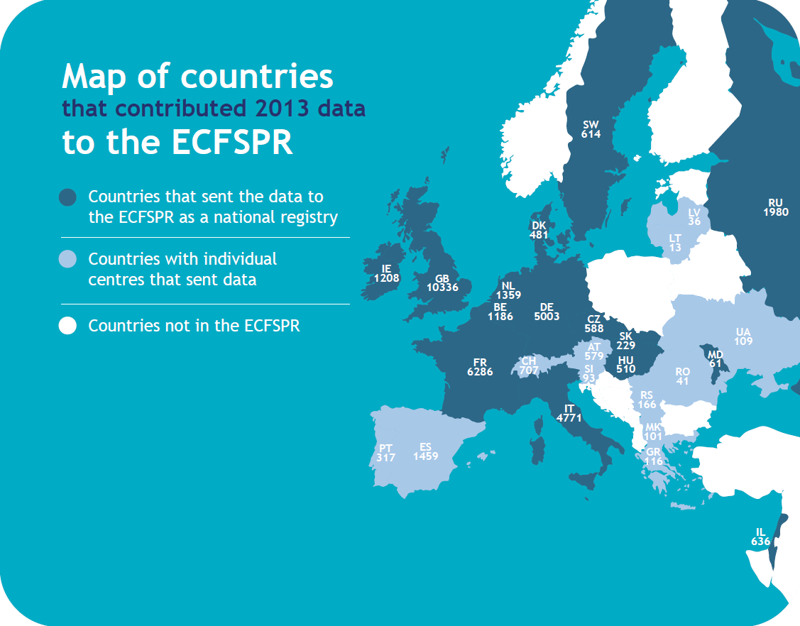

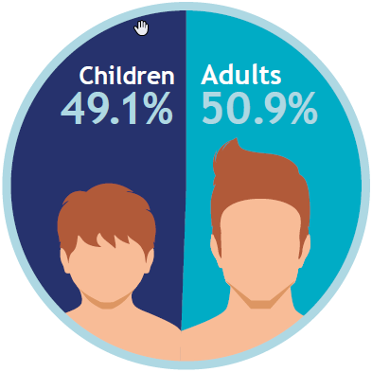
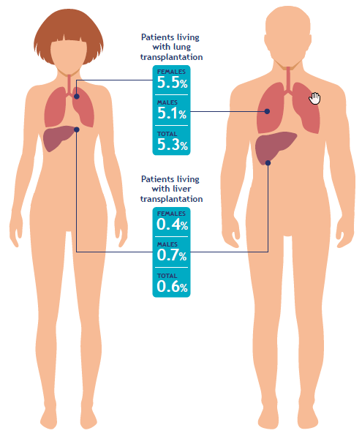
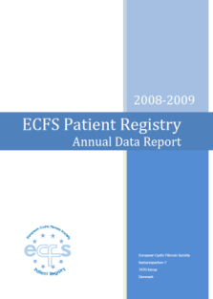
http://www.ecfs.eu/

Slide 5
DISTRIBUTION BY GENDER
TOTAL NUMBER OF PATIENTS: 567
Men: 302
Women: 265
AVERAGE AGE
Men: 17,8 years
Women: 16,4 years
Notes:
In case of Hungary, the ratio of the adult patients are a little bit lower than 50% meanwhile in the EU registry average is a little bit higher than 50%
Men (men, boy group together) are in the majority

Slide 6
NUMBER OF PATIENTS BY GENDER
Number of patients
-Men
-Women
-Boys
-Girls
Notes:
The gap between the men and women is constant but the gap among boys and girls (young generation) is more and more smaller

Slide 7
AVERAGE AGE BY GENDER
-Men
-Women
-All patients
Notes:
The average age of men is higher than women’s
You can notice a throw-back in comparison with 2014 and 2015, but this is when the further analysis enters into the picture: we have data, we have figures about the facts and we have to think about the reason

Slide 8
AGE STRUCTURE
Number of patients
Age (years)
Notes:
Age structurue is a graph showing number of patients grouped by their age. You can see there how many newborns are entered into the system and you can conclude about the effectivity of the diagnosing system as well
Eg: we have 30 patients in the age group 14 which is the biggest group
We have 66 years old patient

Slide 9
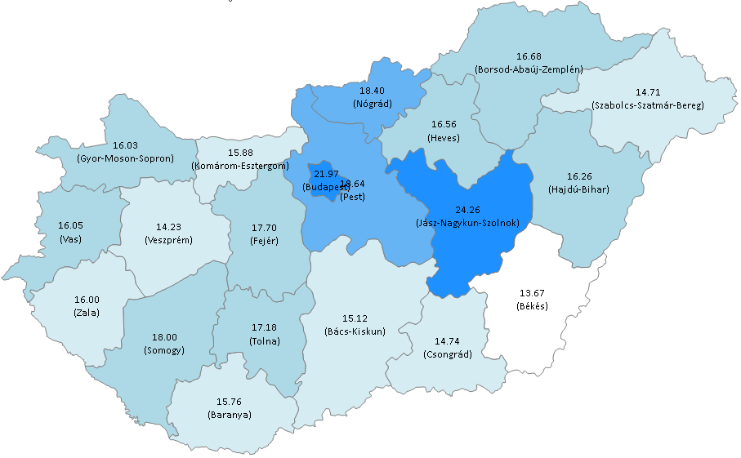
AVERAGE AGE BY COUNTIES
Average age by residence
Most / least populated counties in Hungary:
- Pest: 69
- Jász-Nagykun-Szolnok: 19
- Nógrád: 5
Notes:
Hungary is dividided to 19 counties and Budapest counts as a county in itself
The oldest county is Jász Nagykun Szolnok (average age is 24.26 years ) with 19 registered patient, youngest county is Nógrád with 18.4 years but in this county we registered only 5 patients

Slide 10
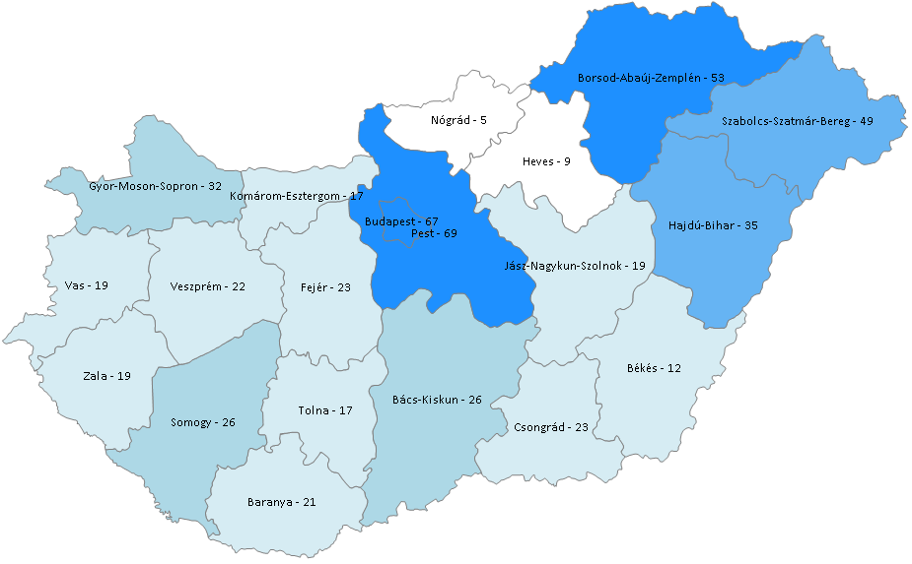
NUMBER OF PATIENTS BY COUNTIES
Numbers by residence
Average age by counties
  BAZ: 16,68
  Szabolcs: 14,71
  Hajdú-B: 16,26
  Budapest: 21,97
  Pest: 18,64
Notes:
There are more patients on the eastern side of the country, especially BAZ, Szabolcs, Hajdú Bihar counties
This could raise the question, why. It could be several reason but the registry is firstly asked questions and then the more professioned people have to ask these questions (with another type or kind of data from the registry)

Slide 11
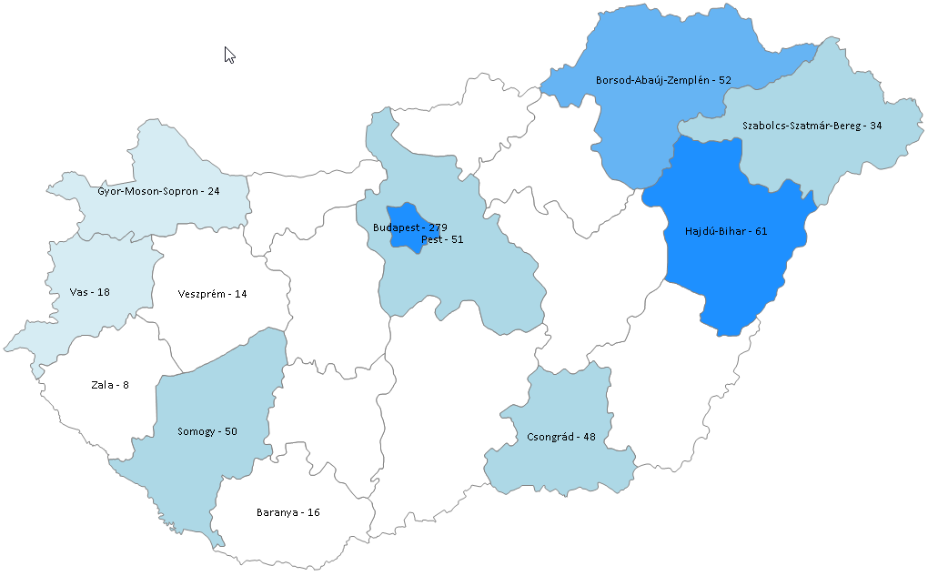
NUMBER OF PATIENTS BY CENTERS
Center names are in red
Miskolc
HP
OKTPI
SOTE GYK
SOTE TüdőK.
Beteshda
Nyíregyháza
Győr
Kenézy
AOK
OEC
Szombathely
Törökbálint
Ajka, Veszprém
Zalaegerszeg
Mosdós
Szeged
Deszk
Pécs
Notes:
We have 18 different locations in the country where CF care is avaiable.
Biggest centers are in Budapest and Pest country (HP – Children, OKTPI – Adult , we will visit Korányi where the CF center has been reconstructed)
There are university hospitals where CF care teams are working (Pécs and Szeged on the South, Debrecen on the East and the SOTE universities in the capital, Budapest)
In Budapest the tx and tx-post care are both avaiable

Slide 12
NUMBER OF PATIENTS APPROACHING AGE 18
PATIENTS TO ADULT CARE
Number of patients who are going to be handled by adult centers in the following years
BY CENTERS
BP - Heim Pál | 4
BP - Korányi | 3
Debrecen | 1
Győr | 1
Miskolc | 2
Mosdós | 1
Szeged | 4
Szombathely | 2
Törökbálint | 1
Zalaegerszeg | 1
Notes:
Transition among centers are not easy job. Of course it not easy for the patients and make a lot of challenges to the centers
The sender center must prepare the patient and its documents materials and contraversary the recipient center has to make some preparations
In order to forsee these changes and we created this figure to predit how many people and centers will be affected with these trasitions and where in the country

Slide 13
NUMBER OF PATIENTS BY CENTERS
CF CARE
There are 18 different locations in Hungary where CF care is currently avaiable
CENTERS
The biggest centers are Heim Pál Hospital (children) and Korányi Institute (adult). Both are located in Budapest
MULTICENTER PATIENTS
In some cases patients are registered at two or more centers in the same time. The reason of this is mostly the running transition from the pediatric care to the adult center or the distance of the centers
Notes:
- The yellow part of the charts represents the patients who are registered two (or more) centers simultaneously

Slide 14
FEV1% BY AGE GROUPS
Man
Woman
Excluding transplanted patiens
Notes:
The age-specific boundaries of FEV1 shows a progressive decline in lung function
This figure excludes the transplanted patients similary to the European statistics

Slide 15
FVC% BY AGE GROUPS
Man
Woman
Excluding transplanted patiens
Notes:
The age-specific boundaries of FVC , vital capacity shows a progressive decline in lung function
This figure excludes the transplanted patients similary to the European statistics

Slide 16
GENETIC DETAILS
Two known mutations
One known mutation
Man
Woman
Notes:
Explanations: not done means the look for CFTR mutations was never carried out
Unknown: If the analysis was done but only one or no mutations were found
Because of the big number of the possible combinations only the most commonly occuring mutation was shown

Slide 17
GENETIC DISTRIBUTION
dF508 homozygota by age groups
Notes:
We have grouped the patients in F508del homozygous (have two F508del mutations) by age groups
This figure shows us the older patients has more complete genetic analysis in HU because currently we dont have neonatal screening regarding the CF
This is also an example where the registry could show the facts and helps the patient organization to push the decision makers to do further steps introducing eg. the neonatal screening

Slide 18
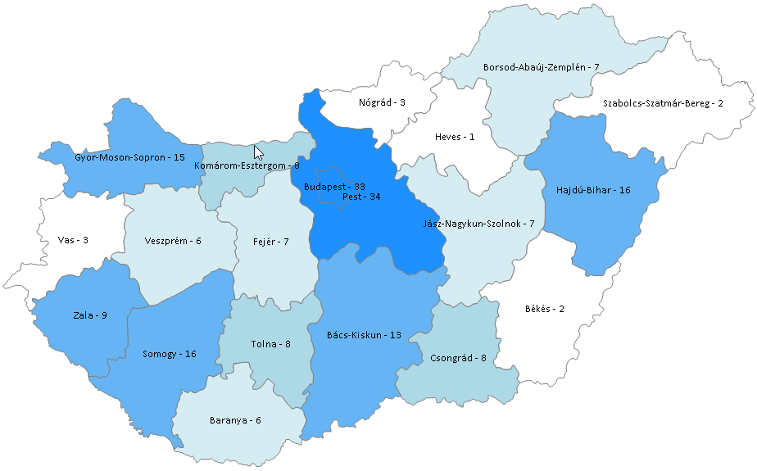
GENETIC DISTRIBUTION
dF508 homozygota by countries
Most / least populated counties in Hungary:
- Pest: 69
- Jász-Nagykun-Szolnok: 19
- Nógrád: 5
Notes:
Geographical distribution of mutation F508del
The mostly affected county is again Budapest and Pest but please remember the figure from the beginning where we the patients number were shown

Slide 19
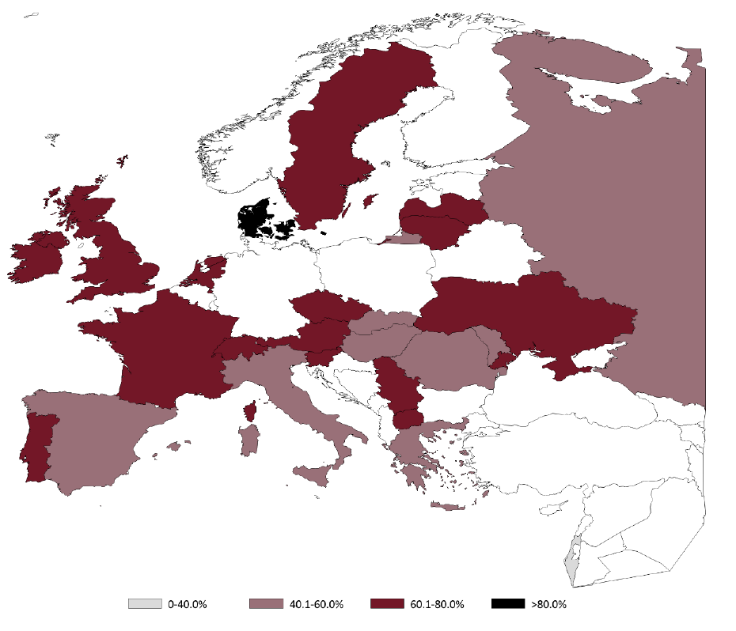
GENETIC DISTRIBUTION
dF508 homozygota by EU countries
Notes:
Although this mutation is the most common in all countries, the allele frequency still varies from 24% in Israel to 82% in Denmark.

Slide 20
KEY MESSAGES
1
TEAMWORK
Segregation of duties
4
2
DATA QUALITY
A chain is only as strong as its weakest link
TRUST
The aim of the registry is to encourage the development instead to initiate meaningless criticism
3
COMPARABILITY
The comparison of CF populations is essential for the development of standards for clinical practice
Notes:
1, It is very important to understand this project is not just about game of one profession. It needs a very strong collaboration of the different approaches, like physicians, statisticans, IT etc
2, data quality is the key of the reliability of the database, if the provided data are not consistent or not acceptable, the whole picture will be malformed
3, the quality of the data provides the quality of the comparability and this makes the mirror for everyone
4, most impotantly trust this picutre because this is a part of us and helps us to improve ourselves

Slide 21
Thank you for your attention!
28.09.2017 – 01.10.2017
Gárdony, Hungary
Facts and figures from the Hungarian CF Registry

