Slide 1
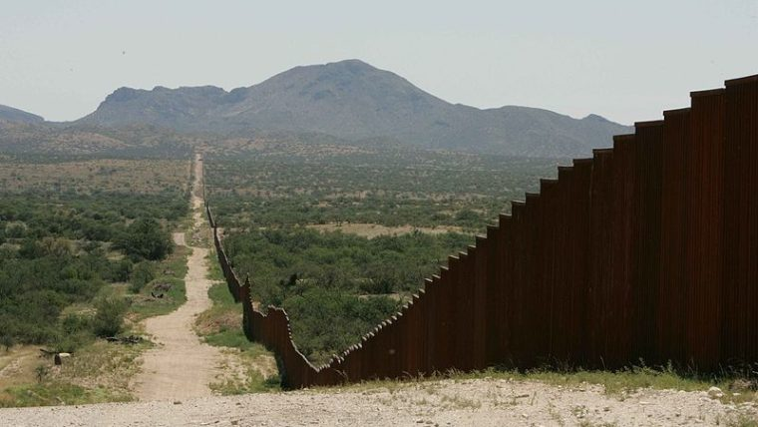
Beyond the border
Better together
2017
Notes:
The title of this lecture: … I suppose all of you know what I mean when I give this title.
Everyday home treatment is very big / intolerable burden…
Robi whatever they constructed during the day collapsed at night, and whatever they built during the night fell to the ground by morning.
I’ve divided 2 parts: 1: summarize the facts 2: whether it is possible to fit it into there life or not.

Slide 2
Everyday home treatment
Inhalation treatment
Expectoration treatment
Physical activity
Notes:
not order of importance
If miss 1 incomplete
Only 3 things to do, but let see the details

Slide 3
Inhalation treatment

Slide 4
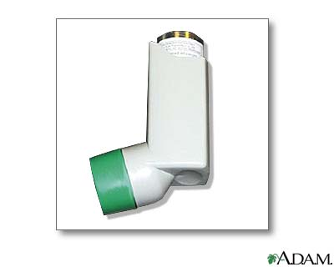
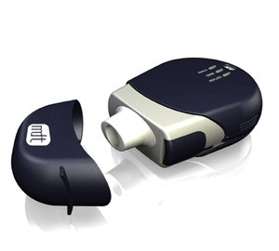
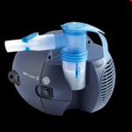
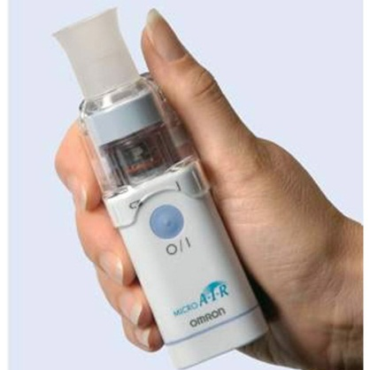
Inhalation
Medicines:
mucolytics, bronchodilators, anti-inflammatories, antibiotics
Devices:
MDI, DPI, Ultrasonic & Jet (compressor) nebulisers
Notes:
We need to make some very important decisions together physician patient PT
Hard important decisions: medicines acceptable? Devices fit to the patient’s possibilities.
So our patients there are already in the decisions but later on they need to do these treatment day by day for years or decades.

Slide 5
Pay attention!
Timing!
Technics!
Output rate (ml/min - time)!
MMD (μm – quality)
Interrupter
Face mask → ← mouth piece (5x more efficient)
Notes:
When, earlier / later, how much time beetwen, before or after sports

Slide 6
Expectoration treatment

Slide 7
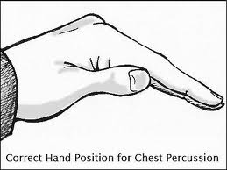
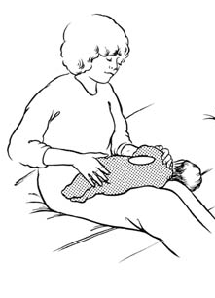
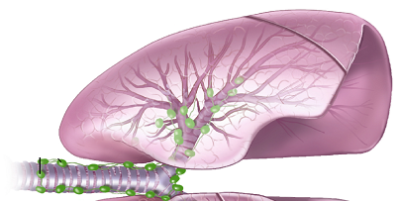
Conventional chest physiotherapy (gold standard)
Postural drainage
Chest percussion
Manual compression
Chest vibration
With or without FET

Slide 8
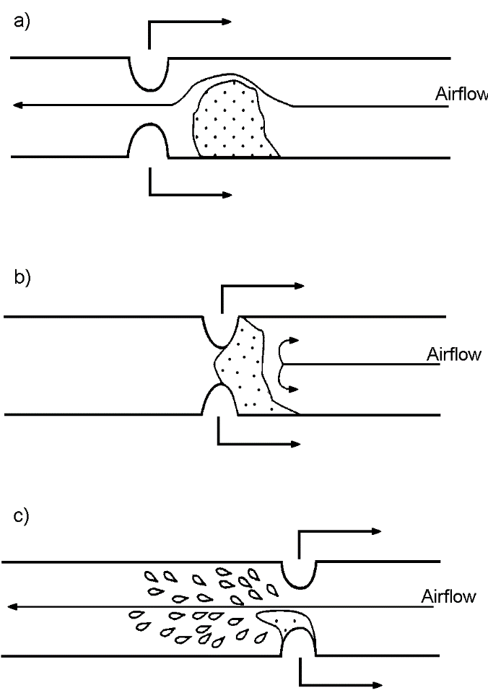
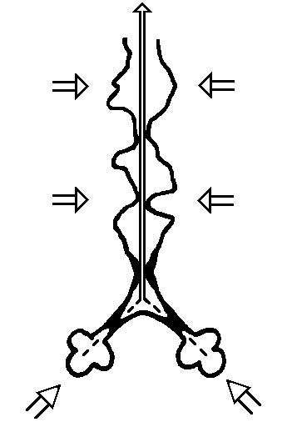
FET, huff, ACBT

Slide 9
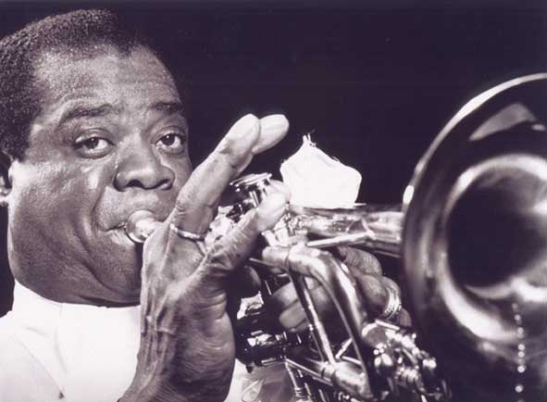

Slide 10
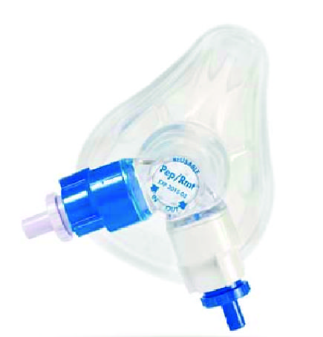
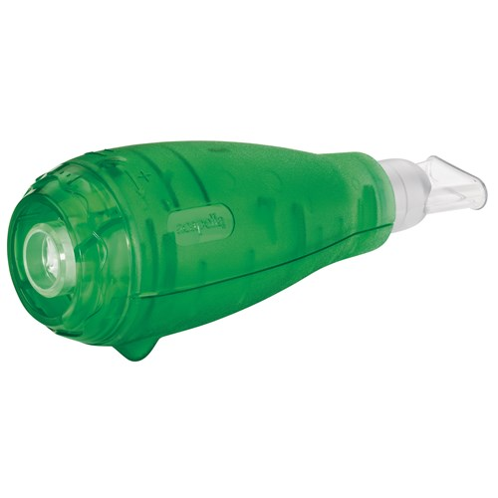
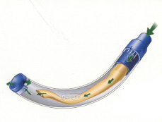
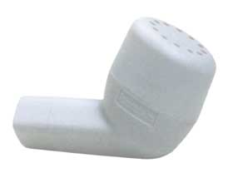
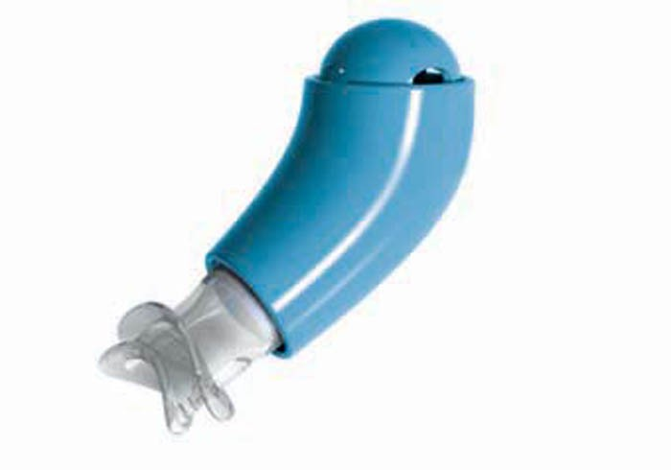
Modern expectoration techniques
PEP – positive expiratory pressure
HiPEP – high pressure PEP
oscillating PEP: Flutter, Shaker, RC Cornet, Acapella
AD – autogenic drainage
MAD – modified autogenic drainage
AAD – assisted autogenic drainage

Slide 11
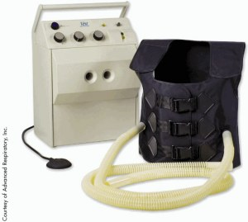
HFCWO

Slide 12
Physical activities

Slide 13
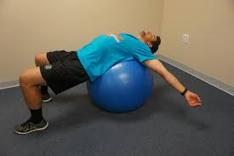
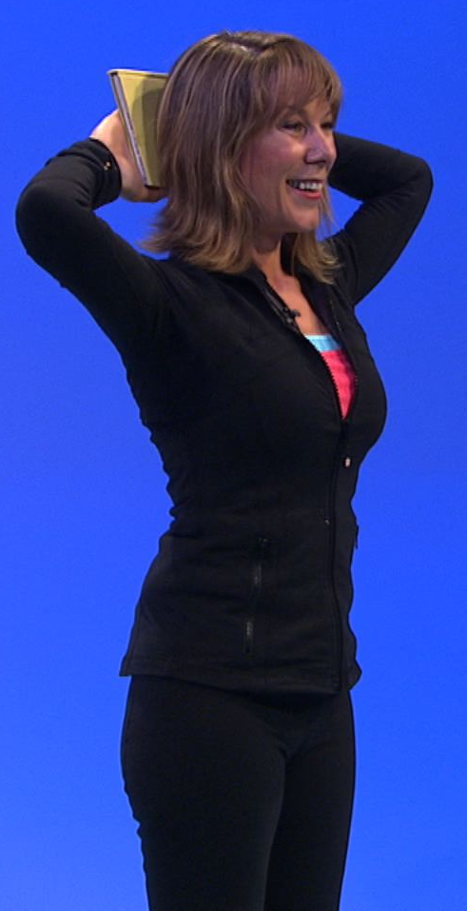


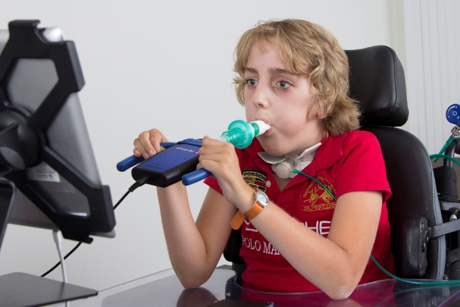
Forms to do
Aerobic exercises
Strength training,
Respiratory muscle training
Chest mobilization
Gait exercises

Slide 14
Aerobic exercises
3-5/week, 60-80% of HR_{max} (symptom limited), 30-50 min.
With or without supplemental O₂ (SaO₂ <90%)
1A (strongest) evidence in pulmonary rehabilitation

Slide 15
Timing: what & when?

Slide 16
In patient (Belgium)
7.15' breakfast and / or nutr. suppl.
7.30' preinhalation: bronchodilators, mucolytics
8.00' expectoration
8.30' postinhalation: antibiotic and / or long term mucolytic and / or steroid
9.00' sport: walking, stairs, swimming
10.00' snack
10.30' BiPAP or. resting, or school
11.30' preinhalation, expectoration, postinhalation

Slide 17
In patient (Belgium)
12.30' : lunch
13.00‚: resting, or school
15.00’: snack
15.30' : chest mobilization
16.00' : preinhalation, expectoration, postinhalation
17.30' : supper
20.00' : snack
night : PEG tube

Slide 18
timing at home: everyday treatment?
Treatment possibilities depending on the patient's condition

Slide 19
good condition
Morning: Pulmozyme
Afternoon: sport
OR:
Afternoon : Pulmozyme then sport or reverse

Slide 20
mild condition
Morning: short act mucolytic inh. → airway clearance (AC)
Afternoon: sport, Pulmozyme
OR:
Morning : short act mucolytic inh. → AC → Pulmozyme inh.
Afternoon : sport

Slide 21
moderate condition
Morning : short act mucolytic → AC
Afternoon : Pulmozyme, sport
Evening: short act mucolytic → AC

Slide 22
serious condition
Morning: short act mucolytic → AC → antibiotic inhalation
Afternoon : Pulmozyme, sport
Evening: short act mucolytic → AC → antibiotic inhalation

